Slide 1

Landing Page Production Guidelines
2020/12/4 - MK Ver1.0
Matsumotokiyoshi Corporate Site
Please read this before you start creating.

Slide 2
1 Must read

Slide 3
1
must-read
About the Guidelines
The Matsumotokiyoshi Corporate Site Landing Page Production Guidelines (hereinafter referred to as the "Guidelines") have been established for the purpose of ensuring that the companies commissioned to produce the Matsumotokiyoshi Corporate Site pages are aware of the This guideline has been established for the purpose of aligning the understanding of
By strictly adhering to these guidelines, we expect to maintain or improve the quality of the website and shorten the time required for production and release.
Scope of Application of the Guidelines
These guidelines apply only to the What's New page of the Matsumotokiyoshi corporate website (URL below). https://www.matsukiyo.co.jp/news/XXX (ID for individual notices)
Example: https://www. matsukiyo. co. jp/news/371
This article was published before the establishment of this guideline, so it does not follow the rules of this guideline.
About the contents of the guideline
If any part of the design or coding is not in accordance with these guidelines, please respond to the correction work as soon as possible.
If you have any questions about these guidelines, please contact us.
If there are any deficiencies in these guidelines, we will correct them as soon as possible. Please contact us with the relevant part.
three

Slide 4
2 Design Rules

Slide 5
2-1
design rule
About the design
About the design
When creating the design of the page, please make sure that the design is common to both PC and SP, and that the same basic images are used in the design.
Mobile-first design (prioritizing the look and feel of smartphones) means that it is acceptable for text size, etc. to appear slightly larger when viewed on a PC. If you have no choice but to use different designs, please follow the coding rules described below to separate them.
When coding, please use image coding and design based on the fact that text and buttons are also used as images. Please take into account the font size and appearance when designing for viewing on a smartphone, as the text will be exported as images.
Please also check the html in the _sample folder included in the package. I think it will be a reference when you make a design.
About the font
There is no specification about the font.
Basically, to make it an image coding, we export each text element as an image.
Changing the font of the title, date area, etc. is not allowed. The design is only available in the content area.
5

Slide 6
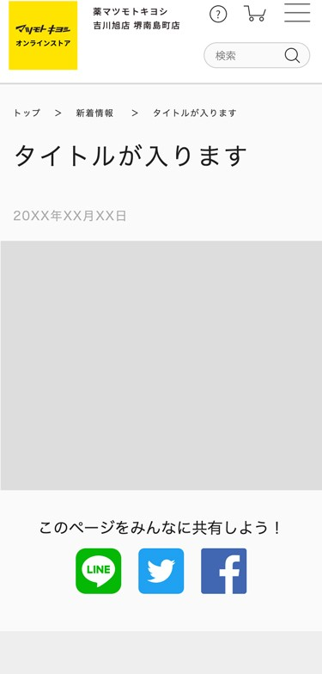
2-3
design rule
About Layout (SP)
configuration
▼ Header
Menu on the upper right
On the ▼ Contents Area
H1 title (breadcrumbs are the same wording as the title)
Release date (Set timer from CMS)
▼ Under the contents area
SNS Share Link
▼ Footer Menu
Lead lines to other pages (omitted in the right figure)
Lines to each SNS are placed directly underneath the content and do not need to be installed separately.
The share text is the same as the description and can be set as desired, but separate text for PC and SP is not allowed.
content area
No width limitation
Footer below
content area
Width No limit
padding: 0 4%; is added to the left and right of the content area.
Please do not display horizontal scrolling.
Height No limitation
6

Slide 7
3 Coding Rules

Slide 8
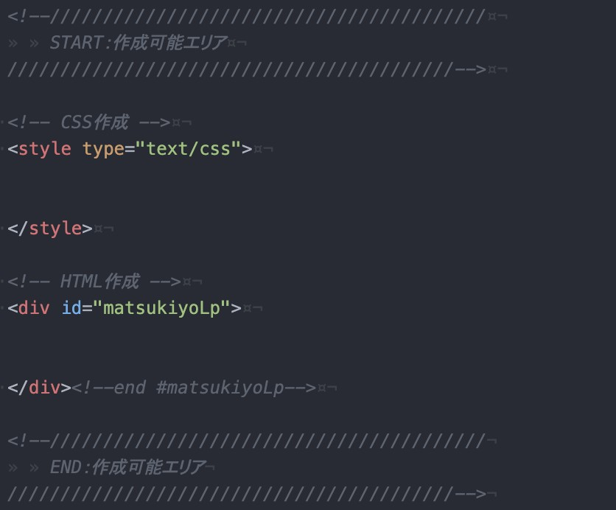
3-1
coding rule
basic requirement
About Notification Management
For the Matsumotokiyoshi corporate site announcement page, the title and content portions are managed by CMS.
For this reason, pages are published by copying the contents in the "Createable Area" from the delivered HTML file to the CMS.
As for the image, upload it to the FTP separately by hand, and rewrite the image path here. Please load the image with relative path when you deliver.
About the guaranteed operating environment and recommended browsers
Please refer to the following for the guaranteed operating environment and recommended browsers. https://www.matsukiyo.co.jp/guide/qa/view/101 https://www.matsukiyo.co.jp/guide/qa/view/174
precautions
Do not tamper with anything in the body except the "Createable Area".
The comment out of "START: area that can be created" and "END: area that can be created" is left in the template (see the figure on the right).
The title of the h1 is outside the area where it can be created, but it should be listed as an exception.
style description
Please do not delete the id #matsukiyoLp that has already been given.
content area
Also, do not style #matsukiyoLp itself directly. Do not create a new tag to enclose #matsukiyoLp.
The css should be written in the style tag of the template, not as an external file.
nine

Slide 9
3-2
coding rule
About coding ①
About html
Regarding the page, please be sure to use the template we sent you and create it in one piece of html that can be used for both PC and SP. The breakpoint (CSS switching point) is [SP] max-width:896px [PC] min-width:897px.
The design is based on the common design for PC and SP, but if you have no choice but to use a branch for PC/SP width, please use the <picture> element for images. Please refer to the implementation in the html in the _sample folder included in the package.
Do not use media queries + display: none; to display images and links (e.g. <a/> tags).
Because the parameter is given to the link (a href) after delivery, and because it affects the display speed of the page, we will not be allowed to use.
html (OK example): Complete with html only, only necessary images are loaded
<a href="https://www.matsukiyo.co.jp/store/online">
<picture>
<source media="(max-width: 896px)" srcset="img/lp-img07-sp.jpg"> <! -- If width is less than 896px, display lp-img07-sp.jpg -->
<img src="img/lp-img07-pc.jpg" alt="Switch button"> <! -- If other than above (width 897 or more), display lp-img07-pc.jpg -->
</picture>.
</a>
html (NG example) ①: a tag is separated by style, and the time to give parameters increases.
html (NG example) ②: Images are separated by style, and both images are loaded.
<a href="https://www.matsukiyo.co.jp/store/online" class="sp_none">
<img src="img/lp-img07-pc.jpg" alt="Switch button">
</a>
<a href="https://www.matsukiyo.co.jp/store/online" class="pc_none">
<img src="img/lp-img07-sp.jpg" alt="Switch button">
</a>
<a href="https://www.matsukiyo.co.jp/store/online">
<img src="img/lp-img07-pc.jpg" alt="Switch button" class="sp_none">
<img src="img/lp-img07-sp.jpg" alt="Switch button" class="pc_none">
</a>
It is assumed that display: none; is applied to .pc_none and .sp_none by media query.

Slide 10
3-3
coding rule
About Coding ②
About css
To avoid conflicts with existing css styles such as header and footer, be sure to inherit the id of #matsukiyoLp and describe the style. Example: #matsukiyoLP h1{ xxxx : xxxxxx ; } If you apply style to h1 directly, it will affect the title of the announcement.
Do not load reset.css in a separate file.
Only coding that can be done only in the content area is allowed.
If you have no choice but to reset it, please do so after specifying the tag in the "createable area" instead of specifying the body.
About JS,JQuery
Notice page jQuery version
1.9.1
<script src=""></script> and CDN is not available.
If you want to use JS, please put the source code in the "Createable Area" and embed it directly.
[Notes.]
We do not allow the use of libraries or plug-ins that may cause conflicts with existing JS files.
If you use JS, please make sure to check the range of influence and verify the display in all recommended environments.

Slide 11
3-4
coding rule
About Coding ③
About the image
Extensions should be all lowercase.
NG example) img_main.JPG
All file names should be single-byte alphanumeric characters and should not contain Japanese characters.
When separating numbers and words, do not use single-byte spaces, but use "- (hyphen)" or "_ (underscore)" to separate them.
NG example) main visual.jpg (written in Japanese) img main.jpg (separated by a space)
About alt
Please put alt in all of the text in the image or a description that shows what the image is about. If you don't need alt setting such as decorative images, please put "alt="".
About the font
There is no specification about the font.
In addition, since the coding is basically image coding, it is not possible to load separate font files such as webfont. If text insertion is unavoidable, we will use the same font as the Matsumotokiyoshi corporate site.

Slide 12
4 Delivery Rules

Slide 13



4-1
About delivery
final proofreading
Please store the file in the "YYMMDD_matsukiyoLP" folder provided with these guidelines and deliver it.
Before delivery, please read these guidelines again and make sure that there is nothing that violates these guidelines. If there are any deficiencies after delivery, please respond to the corrections as soon as possible.
delivery file
Please rename the folder "YYMMDD_matsukiyoLP" to the delivery date.
If you have other deliveries such as banners or mail magazines, please create a separate folder and do not store them in the YYMMDD_matsukiyoLP folder.
YYMMDD_matsukiyoLP
Please change YYMMDD to the date of delivery.
Example: Delivery on October 1, 2020 → 201001_matsukiyoLP
news.html
Please specify the image in the img folder with a relative path so that you can open it directly in a browser and check it. Please make sure that you have filled in the h1 notice title and description (optional).
img
Please store the image file.
We recommend that you use the same image for both PC and SP, and use a compression tool to minimize the capacity to the extent that the image does not feel rough.
Please refer to the recommended image compression tools listed on the next page.

Slide 14
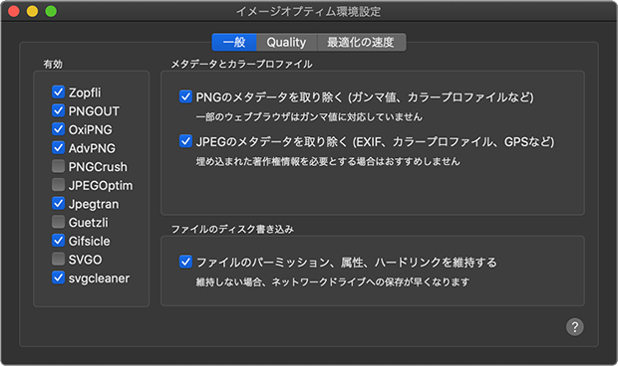
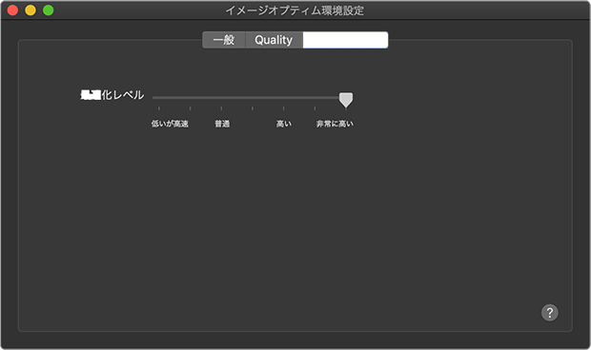
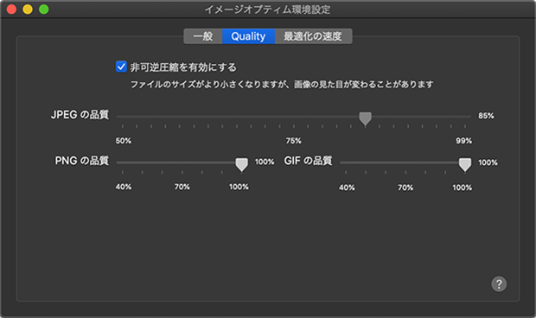
4-2
About Image Compression Tools
Recommended Tools
We recommend that you minimize the size of the image to a point where it does not look rough for posting on a website. There are no specific tools to use, but please refer to the following recommended tools.
ImageOptim | Image compression GUI application for macOS
Antelope | Image compression GUI application for Windows
Squoosh. | Image Compression WebApp by Google
About ImageOptim
Here are the recommended settings for the ImageOptim app for macOS. Please check the screenshot on the right for the app settings.
Supported images: .png, .jpg, .svg
Format and quality to be exported by graphics software
・.png = 8bit(light), 24bit, 32bit(semi-transparent) Any of them is possible
.jpg = Export at 100% quality

